Slide 1
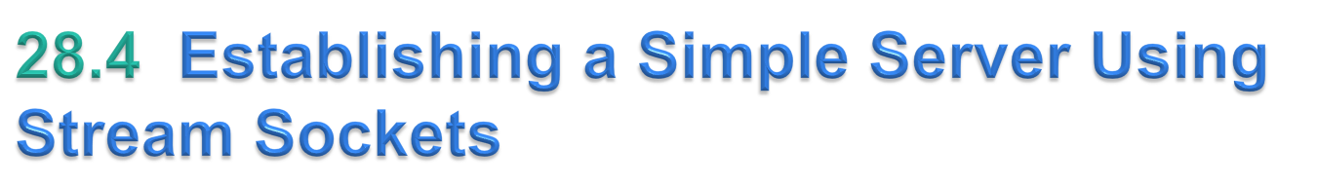
Establishing a simple server in Java requires five steps.
Step 1 is to create a ServerSocket object.
ServerSocket constructor
    ServerSocket server = new ServerSocket( portNumber, queueLength );
The constructor establishes the port number where the server waits for connections from clients—a process known as binding the server to the port.
Each client will ask to connect to the server on this port.
© Copyright 1992-2012 by Pearson Education, Inc. All Rights Reserved.

Slide 2
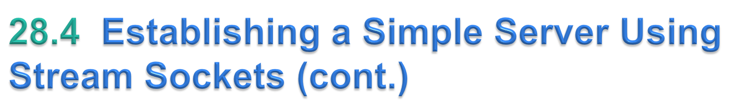
Programs manage each client connection with a Socket object.
In Step 2, the server listens indefinitely (or blocks) for an attempt by a client to connect.
To listen for a client connection, the program calls ServerSocket method accept, as in
    Socket connection = server.accept();
  returns a Socket when a connection with a client is established.
The Socket allows the server to interact with the client.
© Copyright 1992-2012 by Pearson Education, Inc. All Rights Reserved.

Slide 3
Step 3 is to get the OutputStream and InputStream objects that enable the server to communicate with the client by sending and receiving bytes.
  The server invokes method getOutputStream on the Socket to get a reference to the Socket’s OutputStream and invokes method getInputStream on the Socket to get a reference to the Socket’s InputStream.
Step 4 is the processing phase, in which the server and the client communicate via the OutputStream and InputStream objects.
In Step 5, when the transmission is complete, the server closes the connection by invoking the close method on the streams and on the Socket.
© Copyright 1992-2012 by Pearson Education, Inc. All Rights Reserved.

Slide 4
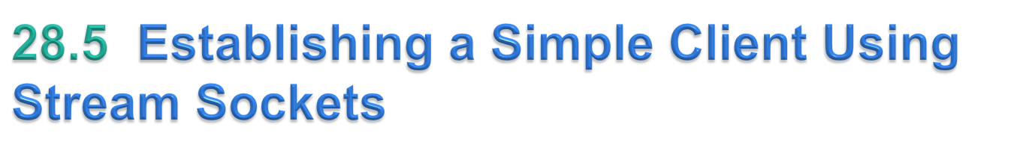
Establishing a simple client in Java requires four steps.
In Step 1, the Socket constructor establishes a connection to the server.
    Socket connection = new Socket(serverAddress, port);
  If the connection attempt is successful, this statement returns a Socket.
  A connection attempt that fails throws an instance of a subclass of IOException.
  An UnknownHostException occurs when the system is unable to resolve the server name.
© Copyright 1992-2012 by Pearson Education, Inc. All Rights Reserved.

Slide 5
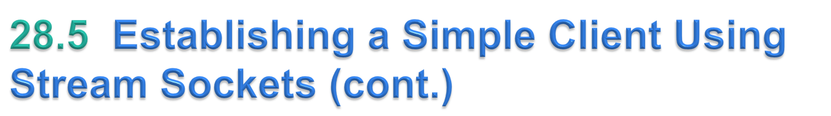
In Step 2, the client uses Socket methods getInputStream and getOutputStream to obtain references to the Socket’s InputStream and OutputStream.
Step 3 is the processing phase in which the client and the server communicate via the InputStream and OutputStream objects.
In Step 4, the client closes the connection when the transmission is complete by invoking the close method on the streams and on the Socket.
© Copyright 1992-2012 by Pearson Education, Inc. All Rights Reserved.

Slide 6
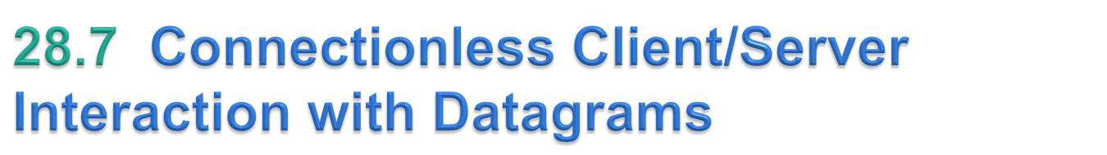
Connectionless transmission with datagrams.
Connection-oriented transmission (TCP) is like the telephone system
  You dial and are given a connection to the telephone of the person with whom you wish to communicate.
  The connection is maintained for your phone call, even when you’re not talking.
Connectionless transmission with datagrams (UDP) is more like the way mail is carried via the postal service.
  If a large message will not fit in one envelope, you break it into separate pieces that you place in sequentially numbered envelopes.
  All of the letters are then mailed at once.
  The letters could arrive in order, out of order or not at all (the last case is rare).
© Copyright 1992-2012 by Pearson Education, Inc. All Rights Reserved.

Slide 7
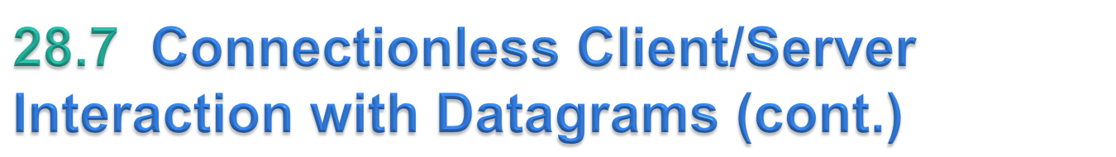
Class Server declares two DatagramPackets that the server uses to send and receive information and one DatagramSocket that sends and receives the packets.
The DatagramSocket constructor that takes an integer port-number argument binds the server to a port where it can receive packets from clients.
  Clients sending packets to this Server specify the same port number in the packets they send.
  A Socket-Exception is thrown if the DatagramSocket constructor fails to bind the DatagramSocket to the specified port.
© Copyright 1992-2012 by Pearson Education, Inc. All Rights Reserved.

